Slide 1
St Paul’s Church of England Combined School and Nursery
Meet the Teacher evening
Monday 16th September 2024
Growing in Strength, Wisdom and Faith

Slide 2
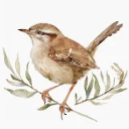

Wren Class
Positive start.
Baseline and next steps. – sent out by Monday 23rd via class Dojo.
Key person - Role
Our St Paul’s Nursery team. – Mrs Sims, Mrs Bennett, Mrs Croall and Mrs Browning.
Growing in Strength, Wisdom and Faith

Slide 3

Our Vision
We rejoice in trials and problems as these produce
endurance and endurance produces
character and character produces hope.
Romans 5 vs3-4
Our school community will be a compassionate
place of enjoyment, respect and hope
where courage is valued and skills developed
for all to thrive in a diverse world;
growing in strength, wisdom and faith.
Courage
Community
Enjoyment
Hope
Respect
Growing in Strength, Wisdom and Faith

Slide 4
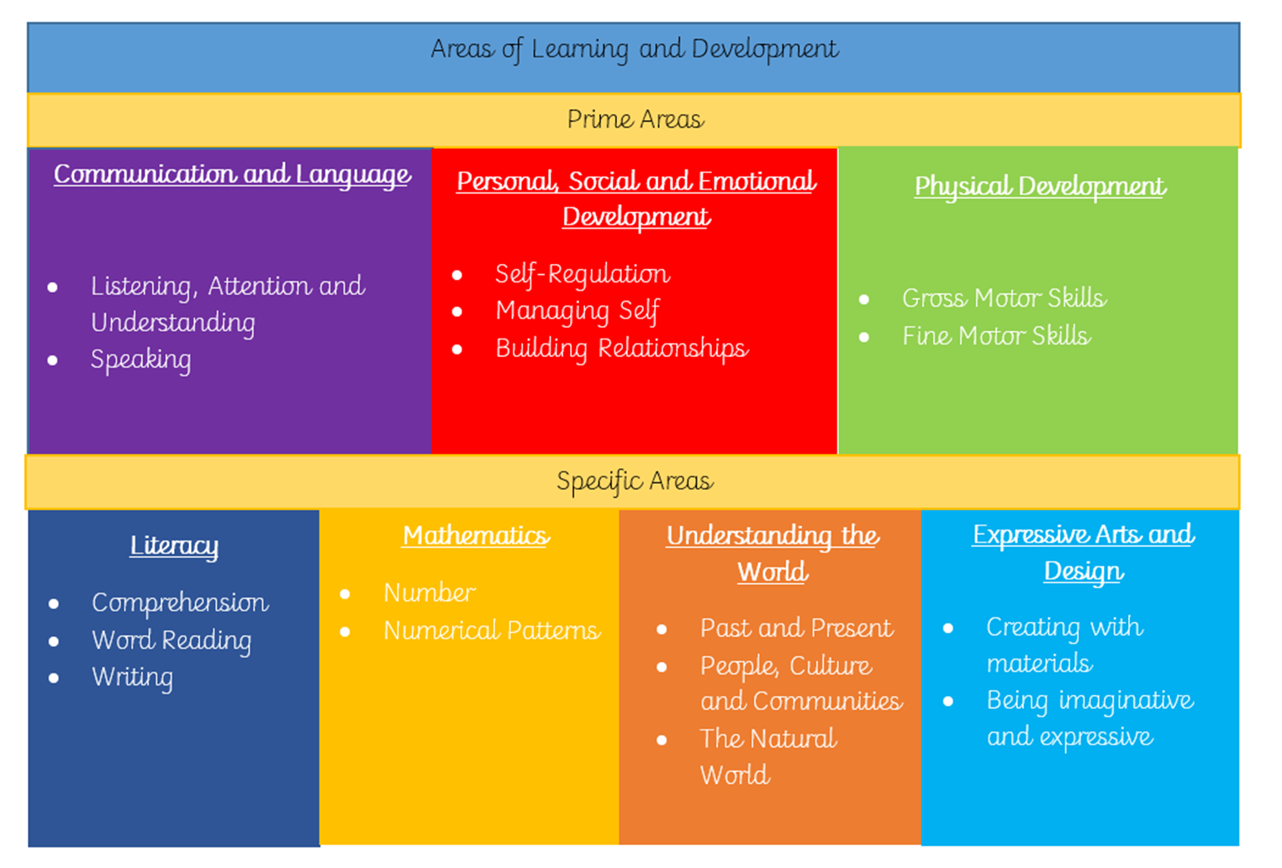
Our Curriculum
Our Curriculum is planned around these areas and each is not a stand alone skill, they are all inter woven into each other to create our curriculum.
We use 4 key element to plan our curriculum
Children’s interests – 3 for me (more spontaneous)
Planned curriculum (following yearly events, seasons etc.)
Areas of support and next steps.
Spiritual, Moral, Social and Cultural Curriculum.- Values, Effective learning dinosaurs, enrichments.

Slide 5
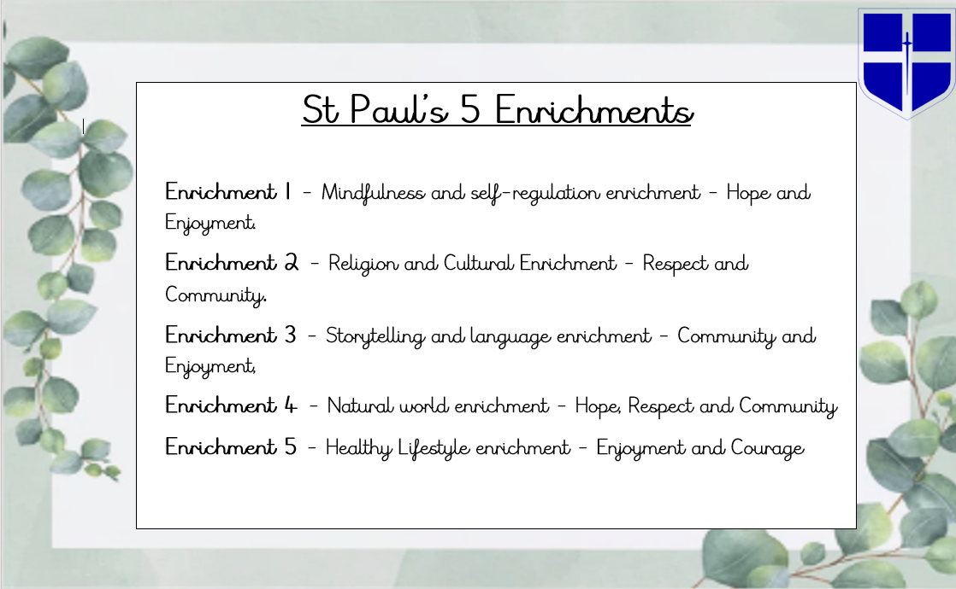

Slide 6
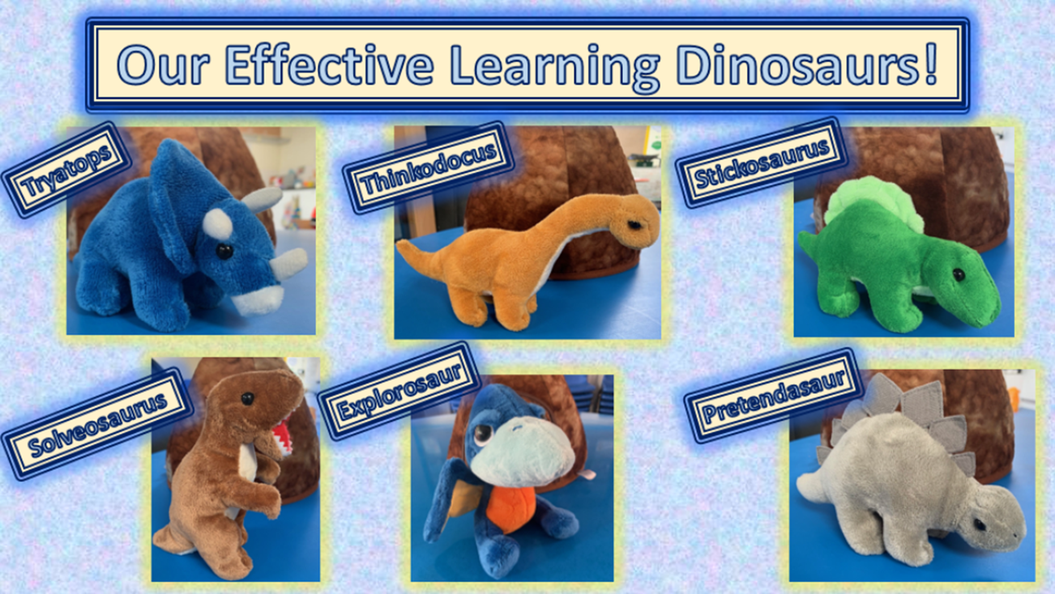

Slide 7
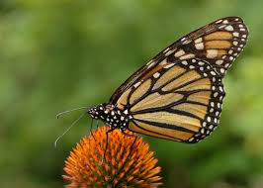
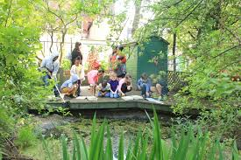
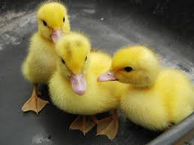
Trips and experiences in Nursery.
Vast amount of activities planned throughout the year linked to our topics and enrichment curriculum including cultural celebrations, experiencing other languages cooking, food tasting, stay and plays and visitors.
Ducklings – Life cycle experience. – w/c 21.4.25
Butterflies – Life cycle experience. w/c 9.6.25
Pond dipping and wood work. – during their time in Woodlands.

Slide 8

Our routine
Soft start – 8.35am – 8.45am
Nursery session begins – 8.45am
9am short circle time and phonics.
9.30am – child led learning.
10am snack time open. (children help to prepare)
Adult led activities happen in key groups
throughout the morning.
11.10am tidy up time
11.20am – story or singing.
11.40am – Reflection and prayer time.
11.45am lunch or morning session home time.
12.15pm – Afternoon session begins.
12.30pm child led learning
1.00pm afternoon circle time and activity
2.00pm afternoon snack opens
2.45pm tidy up time
3.00pm – story book vote and singing.
3.15pm – Home time.
Monday and/or Wednesday – hall session – appropriate footwear and clothes.
Outdoor play – Everyday.
Wednesday afternoon –
Wonder Woodland session.
Growing in Strength, Wisdom and Faith

Slide 9

Class Dojo
Our use of the programme –
Whole nursery communication and updates.
Sharing next steps.
Individual updates on your child and their achievements at Nursery.
Sharing ideas on how to support learning at home – Parents as partners. – weekly home learning grid.
How Dojo will work for parents.
You can share photos and videos of your child’s experiences, learning and achievements at home. Please try to send in posts where possible of special occasions, events, holidays etc. We do share these in Nursery. Posts can also link to home learning and topics in Nursery.
Posts must not be shared on any other social media sights they must remain on Class Dojo where only parents of that class can see.
Please remember read the contract and safer use agreement.
Parents expectations - We will endeavour to send -
1 personal update on your child at least every other week.
1 weekly post suggesting ways to further learning that has been happening at Nursery at home.
Regular updates on group learning and nursery experiences. – Weekly news
Reminders of events coming up and things needed in Nursery.
Growing in Strength, Wisdom and Faith

Slide 10
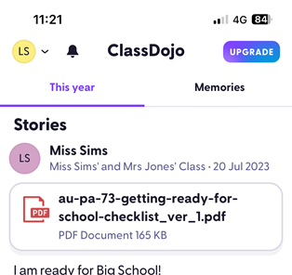
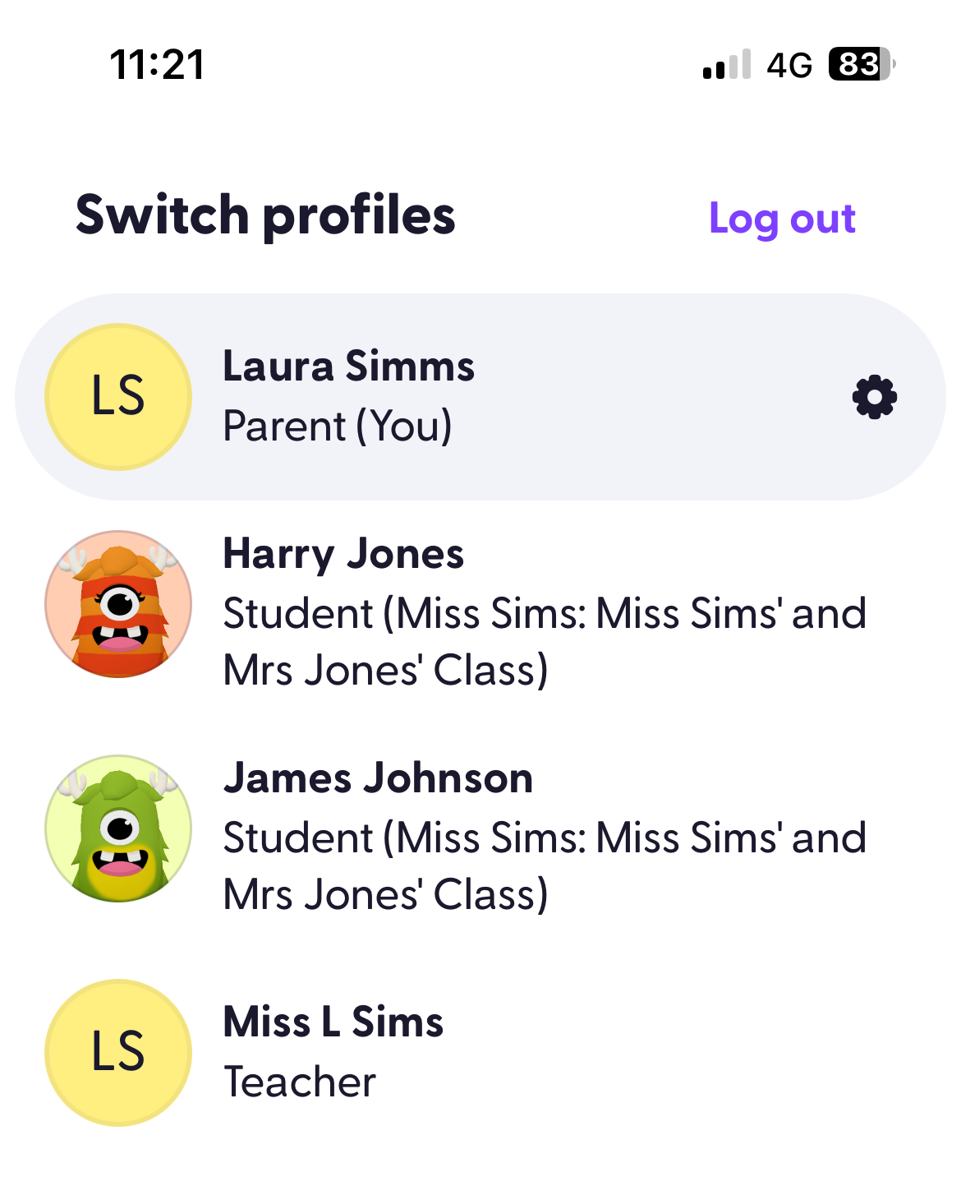
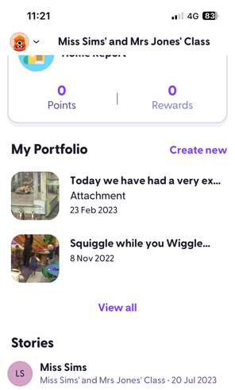
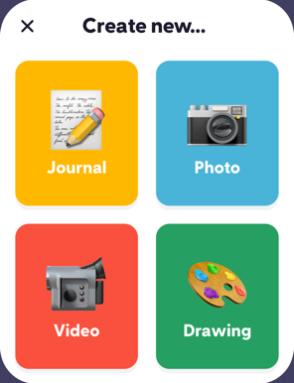
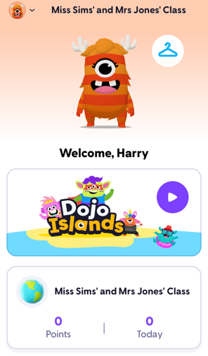

Dojo Demo
You can select up to 10 photos in one post.
You can post video’s but they can’t be longer than around a 1min 30sec.
Go onto the logo on the top left hand corner.
Choose your child’s profile.
Go to create new
Choose the type of file that you would like to upload.

Slide 11
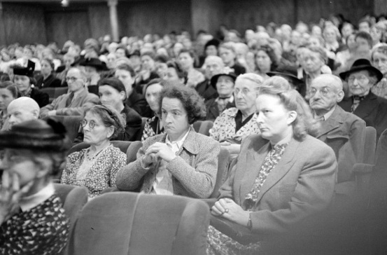



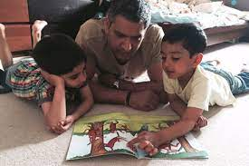



Your Role
Turning up this evening!
Home Learning
Reading
Communication
Parent consultations
Social media and screen use
Volunteering
Growing in Strength, Wisdom and Faith

Slide 12

Parents in partnership.
‘The help that parents give their children at home has a very significant impact on their learning.’ Development Matters Non statutory curriculum guidance for the Early Years Foundation Stage.
‘It is important to encourage all parents to chat, play and read with their children.’ Development Matters Non statutory curriculum guidance for the Early Years Foundation Stage.
‘Engage with Chat: Explore with Play: Read Together
#ChatPlayReadBucks
The golden 10 minutes.
Shared hobbies.
Including your child in household tasks.
https://advertorial.immediate.co.uk/madeformums/lego-duplo/take-10-to-play/ - Lego – Duplo - Take 10 to play.
Growing in Strength, Wisdom and Faith

Slide 13
Home learning
Posted every Thursday on Class Dojo
1 grid with 9 ideas of activities that will support your child’s learning at home linked to our topics
This is NOT home work. It is ideas to support you in providing the best start for your child and opportunities for learning at home to aid your child’s early development.
They will link to topics in Nursery.
We will also send home weekly news and you can discuss this with your child to aid their communication.
We do allow the children a chance to share their experiences from home in Nursery so please do send us these in.

Slide 14


Early reading
‘It is crucial for children to develop a life-long love of reading. Reading consists of two dimensions: language comprehension and word reading. Language comprehension (necessary for both reading and writing) starts from birth. It only develops when adults talk with children about the world around them and the books (stories and non-fiction) they read with them, and enjoy rhymes, poems and songs together.’ – Statutory Framework for the Early Years Foundation Stage – Department for education.
At St Paul’s Nursery we endeavour to -
Develop a love of stories and reading through the use of props, puppets and animation.
Story trays and role play activities to retell stories.
Imaginative story telling.
Inference activities using pictures and stories with no words to make up the story.
Including books in many areas of the Nursery and including books to support adult led activities and learning.
How parents can support this –
If possible get your child a library card and take regular trips allowing them to enjoy the process of getting and sharing new stories together.
Read favourite books over and over again giving your child more ownership over telling the story as they become more familiar with it.
Make up stories using toys and props. – The Magic Story Box.
Follow ideas in the home learning linked to particular stories that we are focusing on.
Always make story time comfortable so that children associate it with warm positive feelings.
Alpha blocks - https://www.bbc.co.uk/iplayer/episodes/b01cz0p1/alphablocks?scrlybrkr=67c1bdcb
Growing in Strength, Wisdom and Faith

Slide 15
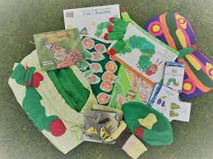
Story sacks
Weekly rotation – Shared on a Friday and return the following Thursday. Please ensure that all parts are complete before returning.
We will send out occasionally on a Thursday if we have children who don’t do a Friday session to ensure that all children have
Opportunities to explore the story further supporting other areas of development.
Re read and use the story in lots of ways while you have it.
Borrow a book House – Please borrow books whenever you want to and return them when you are finished. Any unwanted books can also be donated there for other families to enjoy.
Growing in Strength, Wisdom and Faith

Slide 16
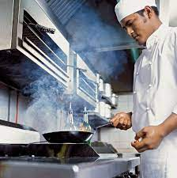
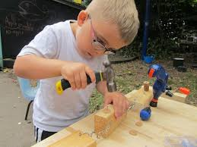

Parent’s influence in Nursery – Let’s build a curriculum tailored to the children.
Stay and plays.
Singing and Storytime sessions.
Mystery Reader.
Parents to influence our curriculum. What can you share with our children?
Next step footprints.
Yearly events.
Charity events.
PTA events
Donations
Painting.
Growing in Strength, Wisdom and Faith

Slide 17



Mystery Reader
Our Mystery reader sessions are designed to give the children a wide variety of stories, read by many different people.
It brings fun and excitement around reading.
Parent volunteers
Sign up today!

Slide 18


Phonics in Nursery
Animaphonics – Our DFE approved programme
Phase 1 phonics – The starting point for all children.
Regular assessment.
Moving onto phase 2.
What is phase 2?
Informing parents.
Supporting your children at home.
Growing in Strength, Wisdom and Faith

Slide 19


Phase 1
In nursery we concentrate on the children’s early listening skills based on a systematic approach through the phase 1 aspects.
We develop these by planning lots of fun activities and games in small groups developing the children’s ability to focus in on sounds, identify the differences between sounds, make their own sounds, explore beats and rhythms, explain sounds and begin to say words orally by hearing the sounds.
There are 7 aspects that we focus on…
■ Aspect 1: General sound discrimination – environmental sounds.
■ Aspect 2: General sound discrimination – instrumental sounds.
■ Aspect 3: General sound discrimination – body percussion.
■ Aspect 4: Rhythm and rhyme.
■ Aspect 5: Alliteration.
■ Aspect 6: Voice sounds.
■ Aspect 7: Oral blending and segmenting.
We will update you regularly on the stage we are focusing on and how you can support this at home using some specific ideas. However in the meantime……
Growing in Strength, Wisdom and Faith

Slide 20
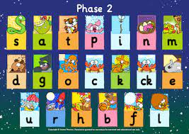
Phase 2
Moving on to Phase 2.
Teaching the single sounds including the letter name and sound.
How you can help – when talking about sounds with your child e.g. sounds in their name or looking at the alphabet teach them the sound as well as the name.
Ensure you only teach the pure sound.
https://www.youtube.com/watch?v=BqhXUW_v-1s
- Video demonstrating the pure sounds.
Keeping you up to date.
Growing in Strength, Wisdom and Faith

Slide 21

Early maths – The expectations in Nursery and how you can help at home.
‘Developing a strong grounding in number is essential so that all children develop the necessary building blocks to excel mathematically. Children should be able to count confidently, develop a deep understanding of the numbers to 10, the relationships between them and the patterns within those numbers.’ – Statutory Framework for the Early Years Foundation Stage – Department for education.
Emphasis on children having a deep understanding of numbers to 5 and then 10 and having an embedded understanding of these numbers and how they work before moving on. - Number blocks – BBC iPlayer. https://www.bbc.co.uk/iplayer/episodes/b08bzfnh/numberblocks?scrlybrkr=67c1bdcb
Subitising – Playing dice games, noticing EVERYTHING!. https://www.online-stopwatch.com/chance-games/roll-a-dice/
Counting and knowing an end point. – Model counting all the time and also ways to make counting easier e.g. lining up objects so that you can count them and stop at the end of the line.
Recognising numerals to 5 and matching amounts – play games that involve children matching a numeral to a group of objects.
Show finger numbers – While singing songs and saying amounts to children hold up your fingers as well to help them develop understanding of showing amounts on there fingers.
Growing in Strength, Wisdom and Faith

Slide 22

Developing a Growth Mindset.
Links with our learning dinosaurs.
What is a growth mindset?
It is the belief that hard work, practise, trying hard and resilience will help you to learn new things and develop. A fixed mindset is one that is fearful and resistant to new concepts and challenges, fear of failure restricts someone from trying and you believe that you can only do what you can do now.
Young children with a GROWTH MINDSET enjoy learning new things and view challenges with more enthusiasm. Growing their problem solving skills, curiosity and confidence along the way.
Growth mindsets can be encouraged from a very early age.
Growing in Strength, Wisdom and Faith

Slide 23

Top tips for helping your child to build a growth mindset. _
Teach your children it’s ok to be wrong and make mistakes.
Teach them to try out new approaches and ideas when problem solving.
Teach them to keep on trying when facing challenges and difficulty even if they can’t see the results yet.
Teach your child the phrase ‘mistakes help my brain grow’.
Model making mistakes yourself and talk about how to overcome them.
Focus attention on the effort that was made and the approaches taken when learning something new when praising.
Celebrate the mistakes that lead to the achievements made.
Growth mindset questioning.
Growing in Strength, Wisdom and Faith

Slide 24



















Linking growth mindset with a love of reading.
Growing in Strength, Wisdom and Faith

Slide 25

St Paul’s School and Nursery – Woodland area.
‘Outdoor learning boosts confidence, social skills, communication, motivation, physical skills, knowledge and understanding, whilst also developing an increase in children’s self-esteem, self-confidence, ability to work cooperatively and it also helps develop positive attitude to learning. It also enhances children’s opportunities to be creative and imaginative using nature as their classroom.’ - The National Literacy Trust
We plan adult led opportunities within a natural classroom.
We teach various outdoor skills in a natural environment e.g. cooking, woodwork, pond dipping, observing nature and change, orienteering, knotting and more.
The children help to maintain and look after the area as well as use it.
Every Wednesday afternoon.
Equipment and clothes – Full body mud and rain suit in nursery if possible.
Wellington boots.
THICK SOCKS.
Growing in Strength, Wisdom and Faith

Slide 26

Reminders
Please collect children as close to the end of the afternoon session as possible unless needing to collect another children from another school or our school.
Inform us of any absences on the day via an email to the office or phone call to Nursery.
If someone else is collecting your child please send an email, with a password if we have not meant them before. Regular collections can be sent in one email to the office.
Packed lunches should be nut free including sesame seeds and nut oils and should be kept cold with an ice pack.
Children should bring a water bottle everyday and a healthy snack if they wish. Please help them to put this on the trolley in the morning.
All medications must be given to staff directly and a form must be filled in. This includes hand gels, creams, lip balms etc.
Children should have a rucksack with a spare set of clothes in including socks and underwear at all times.
Online permission forms – Class Dojo, general permission for food tasting, snack etc and collection information.
Growing in Strength, Wisdom and Faith

Slide 27


Macmillan coffee morning stay and play.
Friday 27th September 2024 8.45am – 11am
All children are welcome to come if it is not their usual session they just need to have a parent with them at all times.
Please if possible bring your own lidded cup.
Cake donations can be brought in the day before so that we can set up ready for the morning. – Please no nuts in any baked or bought cakes.
We look forward to seeing you all there.
Growing in Strength, Wisdom and Faith

Slide 28
Photos
Please bring in a baby photo – age from about 6 months to a year if possible – by Monday 23rd September.
Please can all parents send in a family photo with a small explanation in the speech bubble – By Friday 27th September (or sooner if possible)
Please can all families send in a photo of the family home by Monday 23rd September.

Slide 29

Safeguarding
Safeguarding is all our responsibilities – if you are concerned about a pupil or would like support for your family please contact the school.
Notes:
Kate

Slide 30
Safeguarding
What does safeguarding look like?
Children knowing who they can talk in and out of school
PSHE lessons
Assemblies
Directed conversations with pupils
ELSA support
Family support
Notes:
Becca

Slide 31
Thank you for listening.
We look forward to working with you on your child’s learning this year.
Thank you
Growing in Strength, Wisdom and Faith

