Slide 1

Welcome to Year 5
Firecrests

Slide 2

Our Vision
We rejoice in trials and problems as these produce
endurance and endurance produces
character and character produces hope.
Romans 5 vs3-4
Our school community will be a compassionate
place of enjoyment, respect and hope
where courage is valued and skills developed
for all to thrive in a diverse world;
growing in strength, wisdom and faith.
Courage
Community
Enjoyment
Hope
Respect
Growing in Strength, Wisdom and Faith

Slide 3
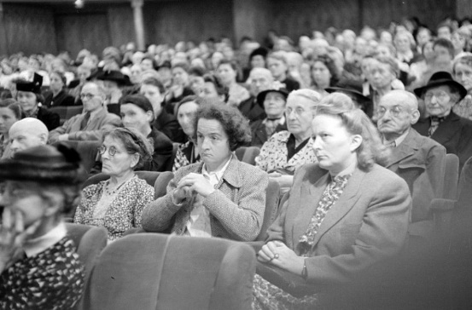



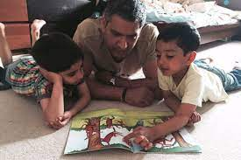



Your Role
Turning up this evening!
Home Learning
Reading
Communication
Parent consultations
Social media and screen use
Volunteering
Growing in Strength, Wisdom and Faith

Slide 4
Our Year 5 Team
Class Teacher – Mrs Walker
TA – Mrs Green
HLTA – Mrs Lenton
PPA Cover – Miss Jones (Wednesday morning)

Slide 5
Our Class Values
  In Year 5 we aim to:
  Have fun
  Support and care for each other
  Value each other
  Work as a team
  Enjoy learning
  Develop confidence
  Encourage independence
  Have a positive attitude
  Have a growth mindset

Slide 6
Expectations
  Uniform – all information on school website.
    https://www.stpaulsschool.co.uk/uniform-information/
    Hair of shoulder length or longer should be tied back with a blue or dark hair tie. Please ensure your child's hair is kept as their natural colour and style without tramlines. No make-up or nail varnish should be worn to school.
    For health and safety reasons, no jewellery, including earrings, should be worn to school.
    Whilst watches are permitted we recommend that children do not have expensive watches as they can be lost or damaged.﻿ Watches should also not have the capacity to send and receive messages or access the internet.
  Behaviour
  PE days – Monday and Thursday
  Home learning
  Being on time
  Communication – via office

Slide 7
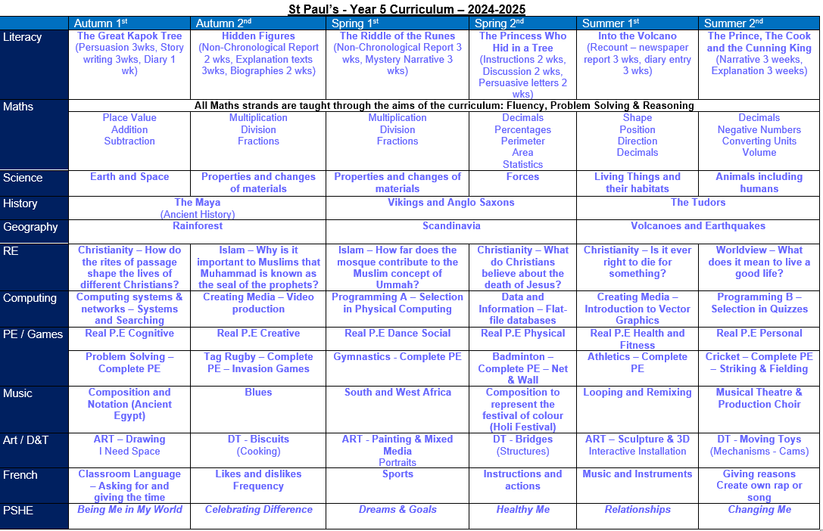
Our Curriculum

Slide 8
Equipment
To be prepared for learning, all children will need:
Pencil
Glue stick (!!!!!)
Ruler
Coloured pencils
Pencil sharpener
A water bottle every day
(No rubbers)

Slide 9
Growth Mindset
Adopting a growth mindset helps us to embrace challenges, use feedback and learn from difficulties and mistakes rather than dwell on them.
Growth mindset vocabulary –
“I like the fact you saw the difficulties as a challenge”
“Well done for trying different strategies when you were stuck”
Don’t say, “What did you do today?” Try, “How did you improve your work today?” Be specific.
The power of yet!

Slide 10


Slide 11
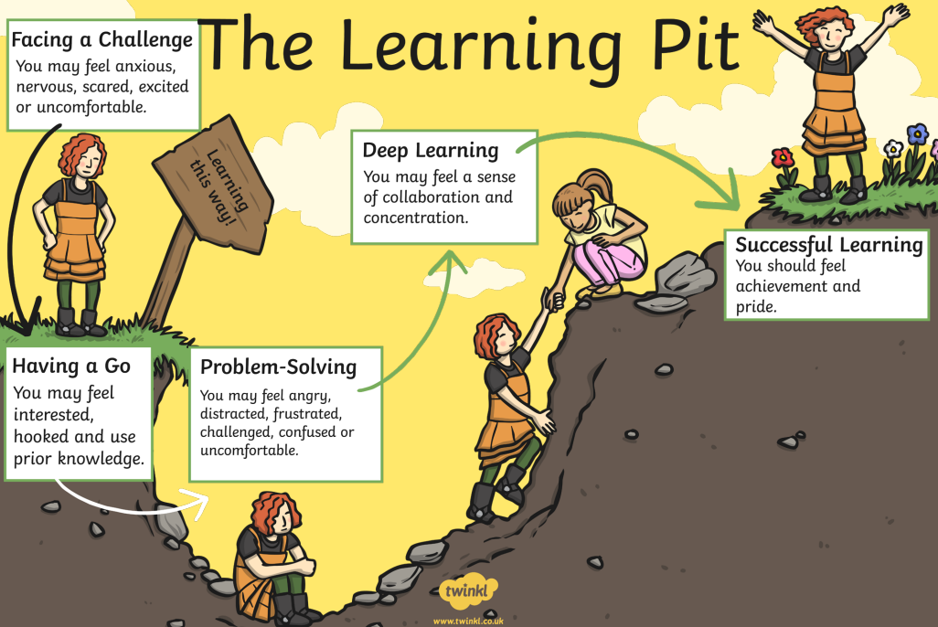


Slide 12
Home Learning
Home Learning will be set on Teams as per the routine outlined below.
Subject and Detail | Day Given Out | Day Due In
Reading Regular reading and discussion of a text with an adult. This should be logged on Boom Reader a minimum of 15 minutes, 4 times per week. | Monday | Monday
Spellings 6 words linked to spelling pattern taught – daily practice. | Friday (daily practice) | Friday (weekly test in class)
Spelling sentences/Spelling Activity – Set on teams Spelling sentences or a spelling activity to support the learning of spelling words each week. | Friday | Friday
Home Learning Choice Select a Home Learning Choice activity from the grid and complete to the best of your ability. This should take approx. 45 minutes. | Friday | Thursday am

Slide 13
Read Regularly
Most important skill! Helps every other subject.
Encourage your child to read daily and record on Boom Reader.
Can be a variety of texts such as children's newspapers and other non-fiction texts.
Read to your child too. Introduces them to new vocabulary and expression.
Remember to follow up reading with comprehension questions.

Slide 14
School Trips
Local trip – Bourne End Library (free). Tuesday 29th April 2025.
Ufton Court – Tudors (paid trip). Monday 9th June 2025.
Residential – 3rd – 4th July 2025.

Slide 15
Production
Year 6 school production
Year 5 – choir
Expected to attend all performances.

Slide 16
Communication
Take opportunities to help children with spellings and times tables when you have spare moments – on way to clubs etc.
Encourage children to let us know if there is a problem so it can be dealt with efficiently
Very important to raise issues of concern quickly
Always here to clarify issues
Please communicate with the school office via email, instead of paper notes
If there are changes to pick-ups please let us know in writing as soon as possible

Slide 17
Useful resources for supporting learning at home
We are very fortunate to have access to some fantastic resources!
Times Table Rockstars
Classroom Secrets Kids
Boom Reader
BBC Bitesize

Slide 18
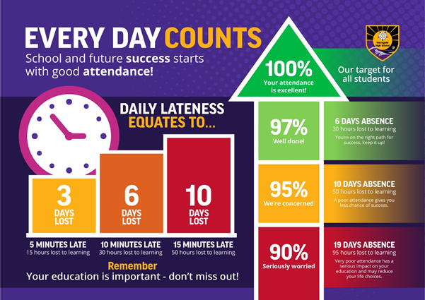
Your Role - Attendance
Notes:
Kate

Slide 19

Safeguarding
Safeguarding is all our responsibilities – if you are concerned about a pupil or would like support for your family please contact the school.
Notes:
Kate

Slide 20
Safeguarding
What does safeguarding look like?
Children knowing who they can talk in and out of school
PSHE lessons
Assemblies
Directed conversations with pupils
ELSA support
Family support
Notes:
Becca

Slide 21
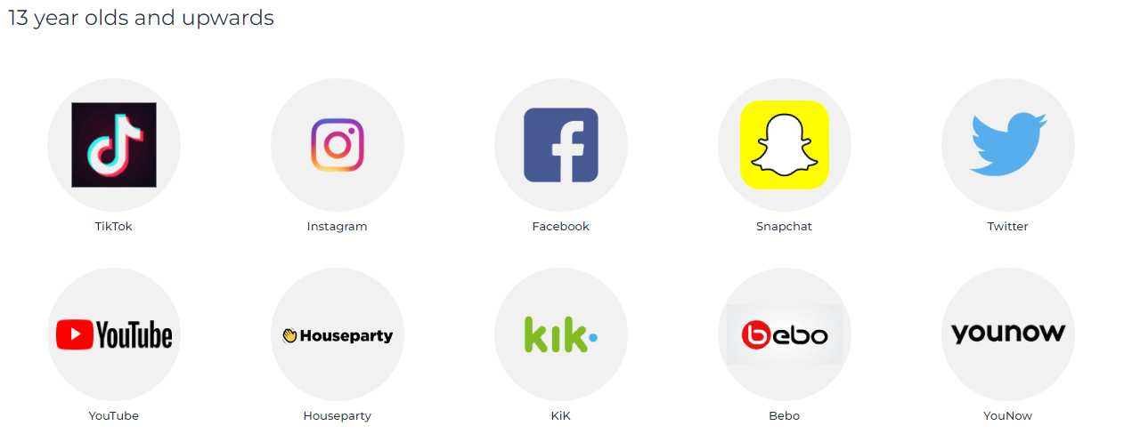

Safeguarding
Online Safety:
Balance between safety and privacy – primary school children are still learning how to manage their use of the internet and conversations whilst on games.
Family agreements on screen time, phone use, what to do if they see something that makes them uncomfortable
Ages for social media – family choice but we recommend monitoring
Notes:
Laura S

Slide 22
Thank you for your time.
Any questions?

